Slide 1
Roll Your Own Connected Field Service With Particle IoT

Slide 2
Jason Lattimer
Development Manager - PowerObjects
Business Applications MVP
Maker of D365 Developer Tools
Blog: https://jlattimer.blogspot.com
GitHub: https://github.com/jlattimer
Twitter: @JLattimer

Slide 3
What Is Field Service?
Data Collection
Mobile
Scheduling
Inventory Management
Time Tracking
Job Tracking
Cloud
Invoicing
Managing off-site workers and resources
GPS Navigation
CRM
IoT
Order Management
Knowledge Bases
Portals
AI
Driver Logs
Predictive Maintenance
Vehicle Tracking
Route Optimization

Slide 4

Dynamics 365 Connected Field Service
Builds on top of Field Service solution
Scheduling
Route optimization
Inventory management
Job tracking
Order management
Invoicing
Knowledge base
Requires Dynamics 365 & Azure
Can be trials and/or different tenants
~Azure costs $200 month to keep running
Available via App Source

Slide 5
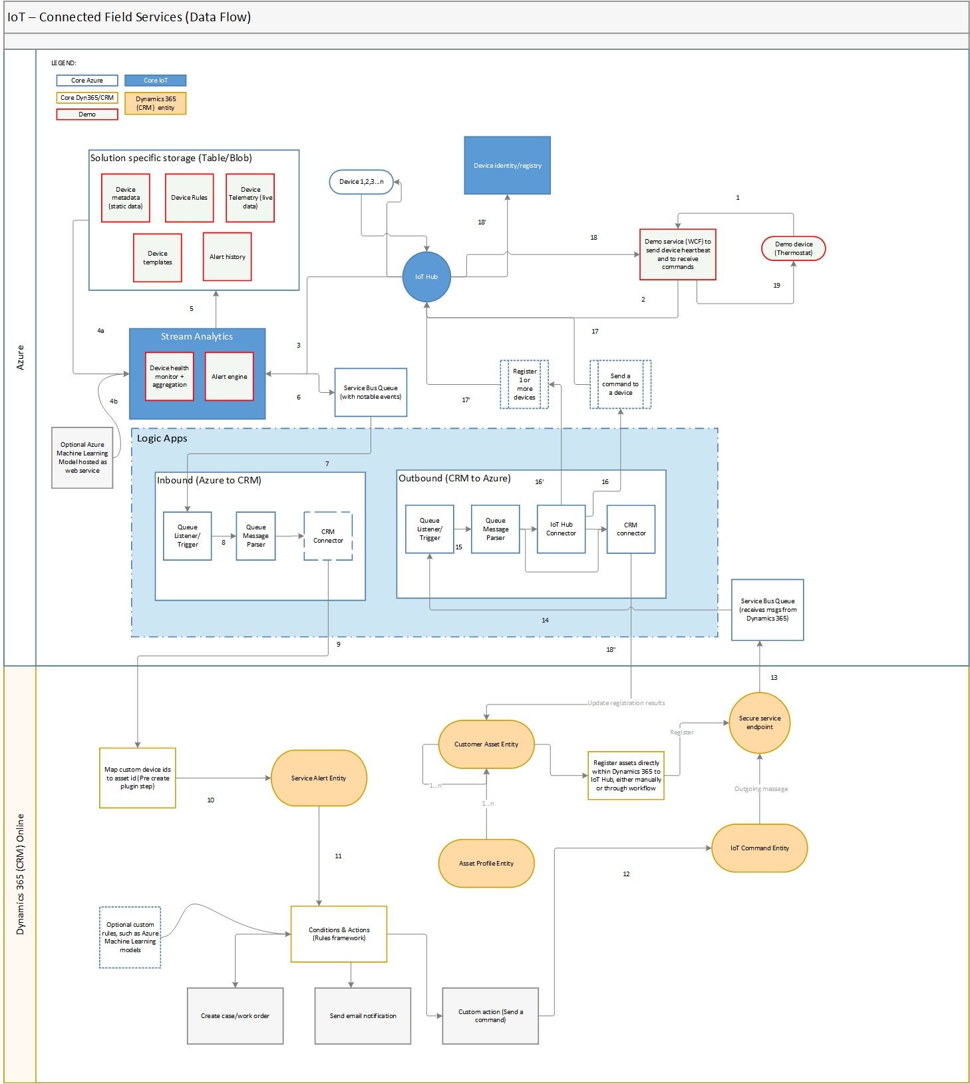
Connected Field Service Architecture

Slide 6
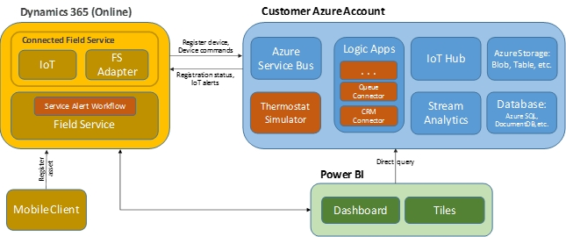
Connected Field Service Architecture
Particle Cloud
IoT Hub
Stream Analytics
Azure SQL
Blob Storage
Logic Apps
Service Bus
Web Apps
Power BI
Dynamics 365

Slide 7
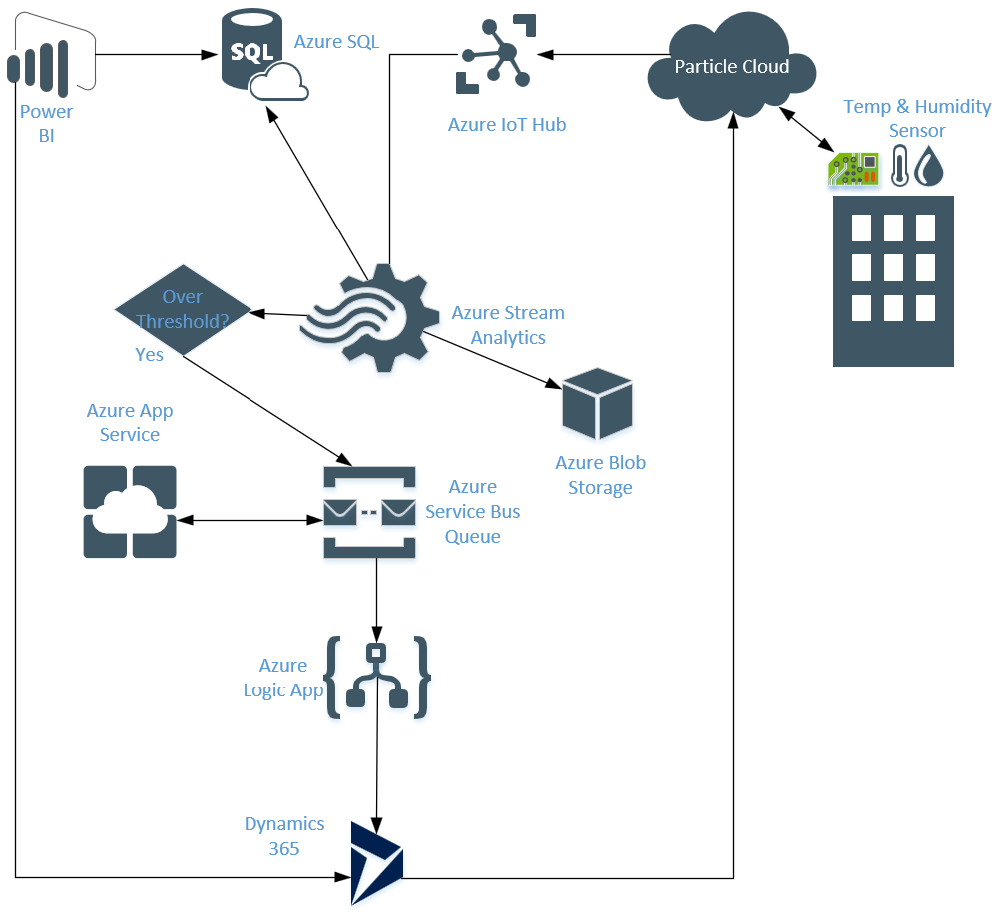
Key Points
Stream Analytics
Routes data to Azure SQL
Read static blob storage
for threshold value
Sends to D365 when over
Logic & Web Apps
Parse messages
Connect to D365

Slide 8
Connected Field Service – Short Comings
Meant to be a template (I assume)
Doesn’t actually connect to a device OOB
Does come with a nice thermostat simulator
Blob storage for blanket alert threshold value
Expensive to leave running
Install process needs work

Slide 9
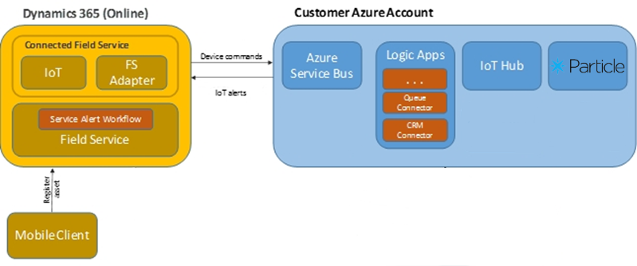
Connected Field Service Architecture
- Simplified
Particle Cloud
IoT Hub
Stream Analytics
Azure SQL
Blob Storage
Logic Apps
Service Bus
Web Apps
Power BI
Dynamics 365

Slide 10
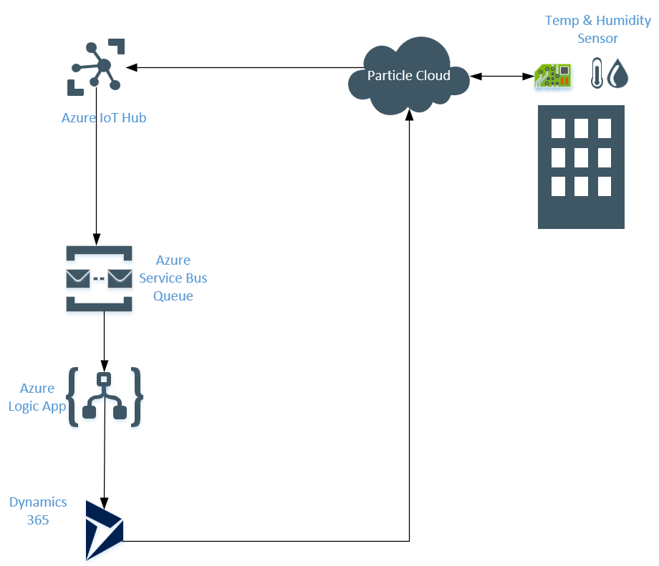
Key Points
IoT Hub
Routes messages
Logic Apps
Parse messages
Connect to D365

Slide 11
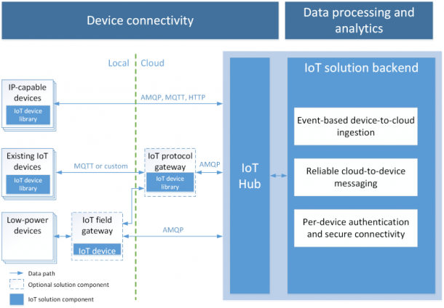
Azure IoT Hub
Endpoint for connecting devices to services
Supports millions of devices
Bi-direction communication
Individual device registration
Free – 8k messages/day
Route messages directly to Service Bus Queues

Slide 12
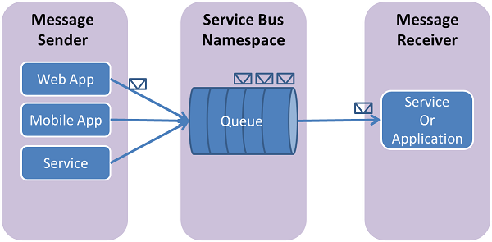
Azure Service Bus - Queue
One-way communication
Stores sent messages
Basic tier
$.05 USD / 1 million / month
Queues only

Slide 13
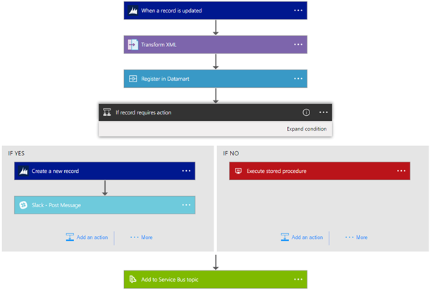
Logic Apps
Cloud workflows
100’s of connectors
Triggers & actions
Actions
$0.000025 per execution
Standard connector
$0.000125 per execution

Slide 14

All-In-One IoT Platform
Devices
Cellular
Wi-fi
Mesh
Device cloud
Device OS
Developer tools
Cellular IoT SIM
https://www.particle.io

Slide 15
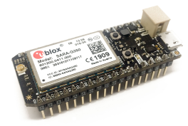
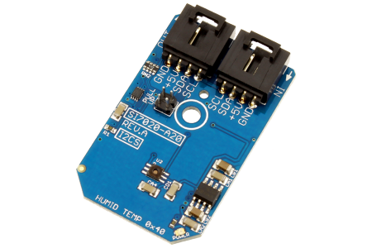
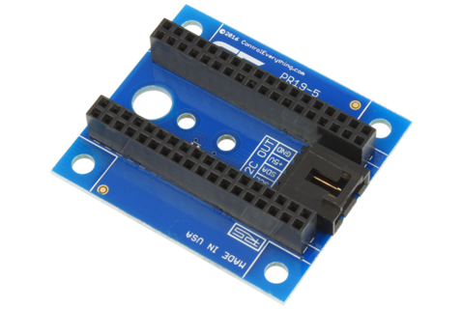
Hardware
Particle Electron
2G/3G cellular – global SIM & data plan
Battery or 3.3v wired
Over the air flashing or USB
Silicon Labs Si7020-A20
Humidity & temperature sensor
Humidity accuracy +/- 4%
Temperature accuracy +/- 4° C
On chip heater
Particle Electron I2C Shield
On board power booster
Connection for sensor

Slide 16
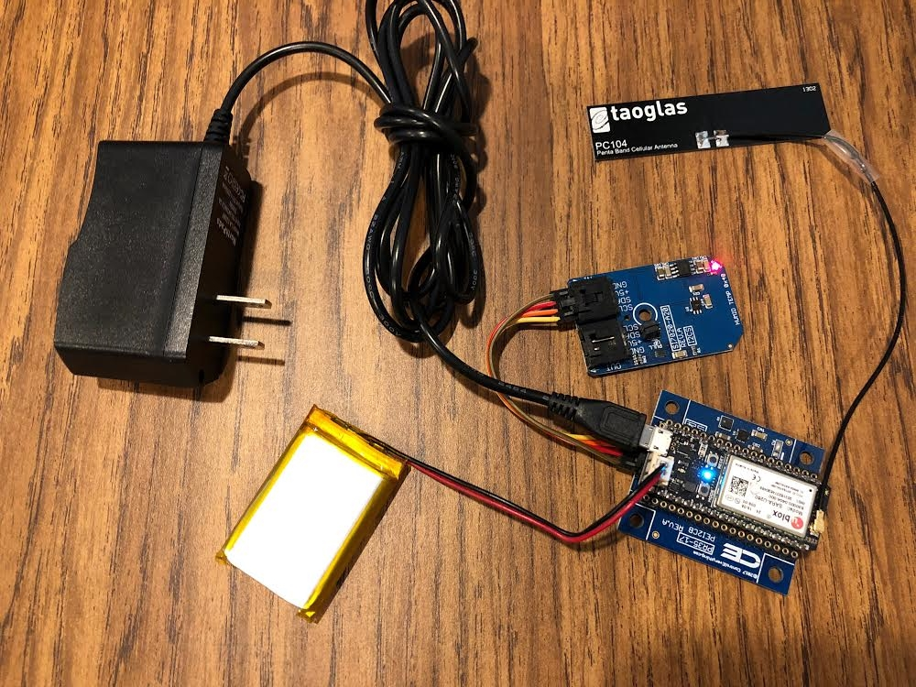
Hardware

Slide 17
Hardware Investment $100-120 USD
Particle Electron – cellular
2G kit - $49
3G kit - $69
Particle Photon – wi-fi
Kit - $29
Silicon Labs Si7020-A20 - $30
Particle Electron I2C Shield - $10
5v AC Adapter - $10

Slide 18
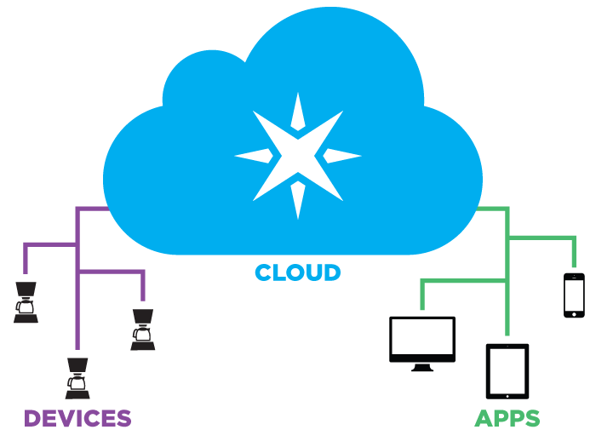
Particle.io – Particle Cloud
Endpoint to connecting devices to other services
Bi-directional communication
Real-time event streaming
Web based development environment
Send data in 1 line code

Slide 19
Particle Development
C++ for firmware code
Utilize existing code libraries
Flash firmware over USB or cellular/wi-fi
Web or desktop (Electron) IDE & CLI
API for cloud service for device interaction
Azure IoT Hub, Google Cloud & Maps, & web hook integrations

Slide 20
Particle Development – Cloud
Get device info
Ping devices
Execute device functions
Get variable values
Flash firmware
Get & publish events
Quarantine devices
Free for wi-fi / included for cellular

Slide 21
Particle Development – Firmware
Publish to cloud service
Variables
Functions
Messages
Subscribe to cloud service events (inter-device communication)
Cellular
Battery
LED
Other device functions

Slide 22
Size Matters
Particle cellular data plan $3 / month USD / 3 MEGABYTES
$.40 MB after
Considerations
Size of data packets
Combining data
Frequency

Slide 23

Demo & Code

Slide 24
Resources
GitHub
https://github.com/jlattimer/RollYourOwnConnectedFieldService
Particle.io
https://www.particle.io
NCD
https://ncd.io
Particle IoT GitHub
https://ncd.io
Microsoft Connected Field Service
https://www.microsoft.com/en-us/internet-of-things/connected-field-service

